Slide 1



learn invent impact
Control Path Model (CPM) for Loop Behaviors
Suresh C. Kothari
Professor, Department of Electrical and Computer Engineering
President & Founder EnSoft Corp.
Acknowledgement: Team members at Iowa State University and EnSoft, DARPA contracts FA8750-12-2-0126 & FA8750-15-2-0080

Slide 2
What is a loop?
Imagine you are talking to your friend on phone. Both of you have the same graph in front of you. You see a loop in the graph, but your friend doesn’t see that loop. How will you help to your friend? You want him/her to understand what a loop is and its entry point.
I would like to hear your ideas in the next class.
Avoid getting readymade answers. You will learn more if you think about it.

Slide 3
Foundation: What is a loop?
A loop is a sequence of nodes A₁, A₂, .. A_{k} such that there is an edge from A_{i} to A_{(i+1)} for i = 1, 2, .. k-1 and there is an edge from A_{k} to A₁
commonly given answer
G =
A1
A2
A3
Does the above definition hold for G ?
Edge from A1 to A2?
Yes
Edge from A2 to A3?
Yes
Definition doesn’t hold
Edge from A3 to A1?
No
Should we change the definition? How?

Slide 4
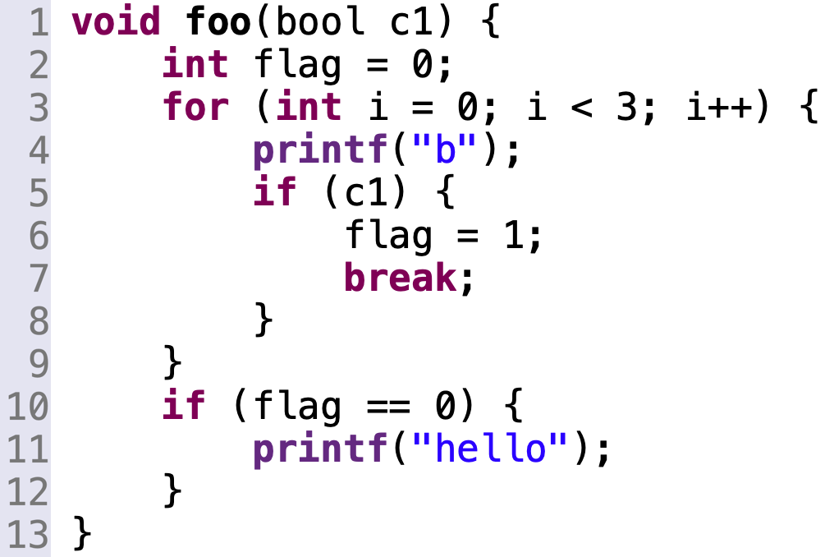
2
1
S
a
a1
h
h
e1
e
b
b
c
e2
continue
a2
c
d
e3
d
continue
Such loops cannot be produced by a program without goto
Will this code produce such a loop?

Slide 5
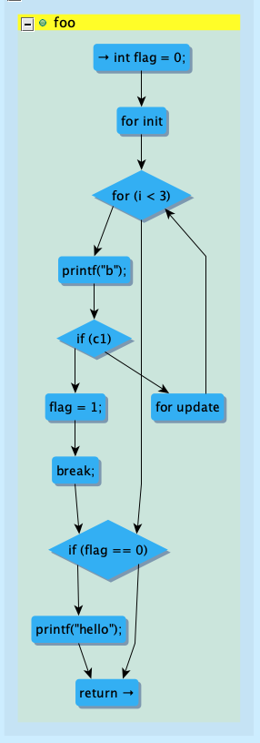
2
1
S
a
a1
h
h
e1
e
b
b
continue
c
e2
c
a2
d
e3
d
continue
Such loops cannot be produced by a program without goto
Will this code produce such a loop?

Slide 6
5
a
continue
h
e3
b
e2
c
e1
d
Will this code produce such a loop?

Slide 7
Foundation: What is a loop?
A loop is a sequence of nodes A₁, A₂, .. A_{k} such that there is an edge from A_{i} to A_{(i+1)} for i = 1, 2, .. k-1 and there is edge from A_{k} to A₁
commonly given answer
Definition: A loop in a directed graph G is a subgraph L such that any two nodes in L are connected by a path.
Instead of loop, the term strongly connected component is used is graph theory.
A1
A2
A3
Three Loops: L1 = {A1, A2}, L2 = {A2, A3}, L3 = {A1, A2, A3}
L3 contains the loops L1 and L2

Slide 8
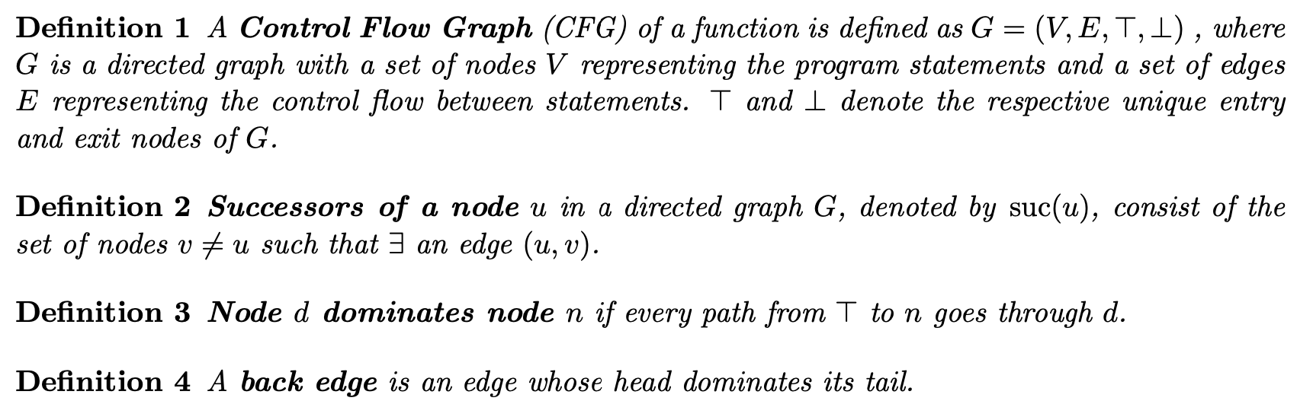
CPM Basic Concepts and Terminology -1
These definitions are from a book. Let’s make a few changes to make it clearer and precise.

Slide 9
CPM Basic Concepts and Terminology -1
not clear
Unique exit is obtained by creating a dummy node E and connecting all RETURN nodes to E
One must first define the successor and then CFG
These definitions are from a book. Let’s make a few changes to make it clearer and precise.
We have first defined the successor relation and then defined CFG as the graph in which edges represent the ordered pairs in the successor relation.

Slide 10
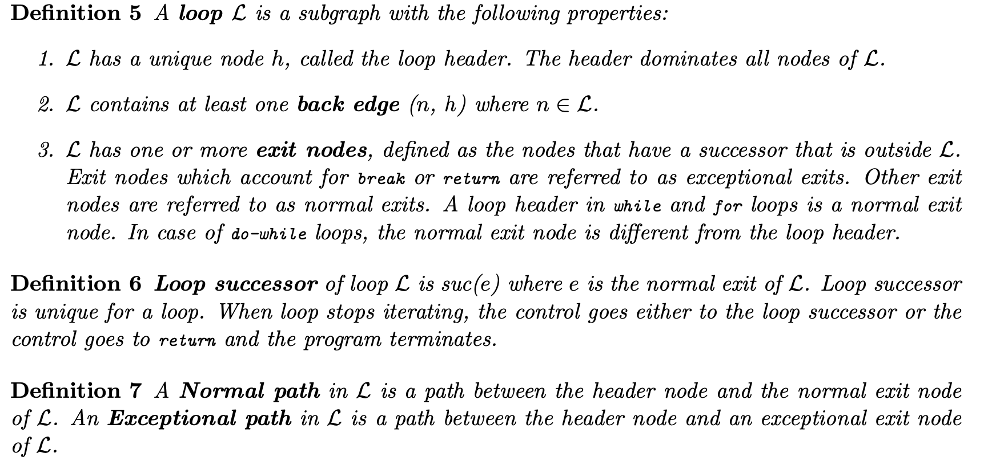
CPM Basic Concepts and Terminology -2
A loop is a strongly connected component
Unique Entry
A normal exit only if the header node is the exit

Slide 11
Consequences of the definitions
A loop has a header if and only if it has unique entry
A loop may not have a header
A header of loop L is a node in L that dominates L
A loop can have at most one header.
Why?
Loop = {A1, A2, A3}
Reminder: A loop is a strongly connected subgraph, i.e., there is path from X to Y for any nodes X and Y in loop
A1
A2
A3
Reminder: A node D dominates Y if every path from root to Y goes through D
B
root
Reminder: Header dominates the loop
Does the loop have a header?
B
A1
A2
A3
Does the loop have a header?

Slide 12
Let’s go through examples to reenforce the concepts we just defined.

Slide 13
e1
e2
e3
e4
A1
A2
A3
E
What are the exit nodes for L?
B
e5
e6
Does L have a normal exit?
L = {A1, A2, A3}
Reminder: Normal exit only if the exit is the header node
Let’s check various loop properties for L
Does L have a normal paths?
Are any two nodes in L connected by a path?
Yes
Reminder: Normal path exits through the header
Does L have a successor?
Does A1 dominate A2?
Does A1 dominate A3?
Yes
Does A1 dominate L ?
Yes
Reminder: The successor of the header is the loop successor .
No
Does A2 dominate L ?
What are the exceptional paths in L?
Reminder: A node X dominates Y if every path from root to Y goes through X
e2e3(e6e3)*
(p)* - denotes p iterates 0 or more times
Is e5 a back edge?
You can write the other paths
Is e6 a back edge?
e2(e6e3)*
Not correct
Reminder: An edge e is a back edge if its head dominates tail
e2(e6e3)*e3
Not correct

Slide 14
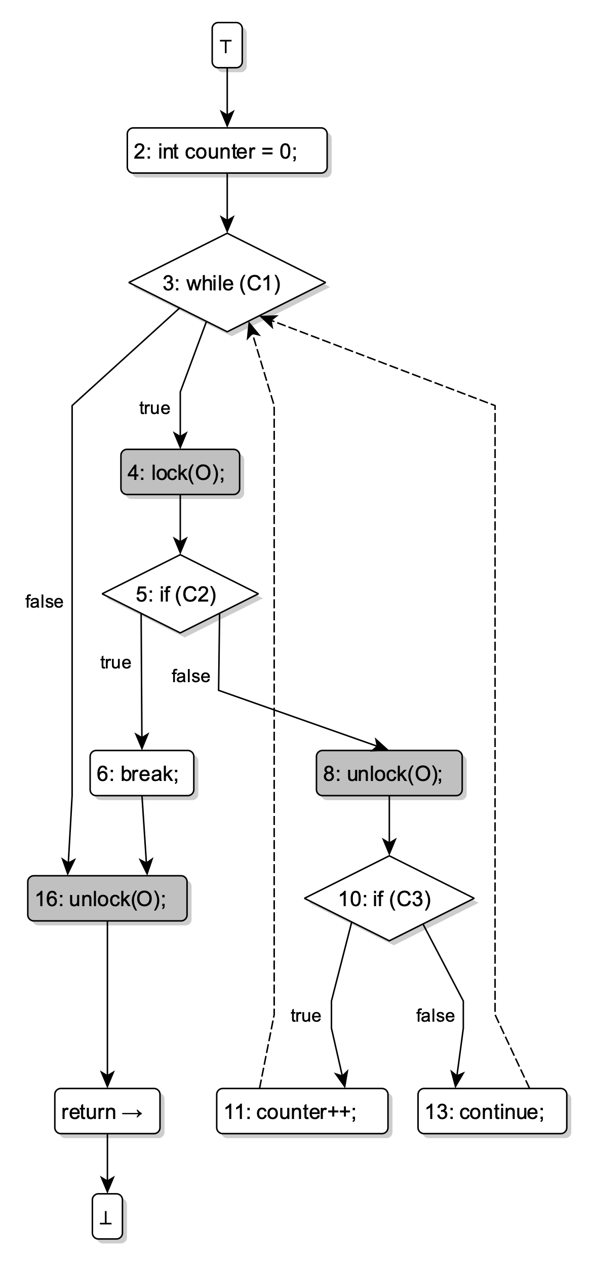
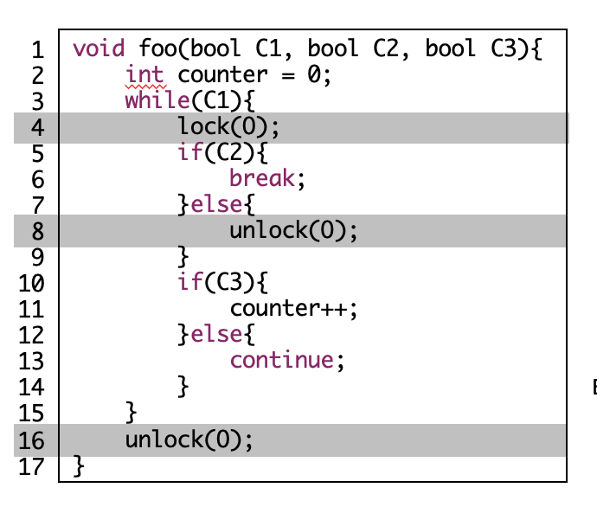
Root
2
3
4
5
6
8
16
10
17
11
13

Slide 15
2
3
4
Loop Body
Loop Header
Loop Successor
Normal Paths
Exceptional Paths
Loop Back Edge
5
6
8
16
10
17
11
13

